Slide 1
Question 1
Ques 1: Use Booth’s algorithm to evaluate −9×−13.

Slide 2
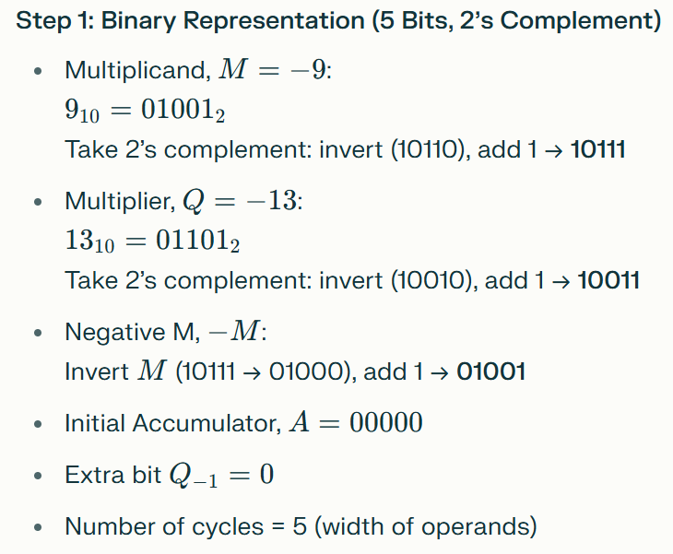
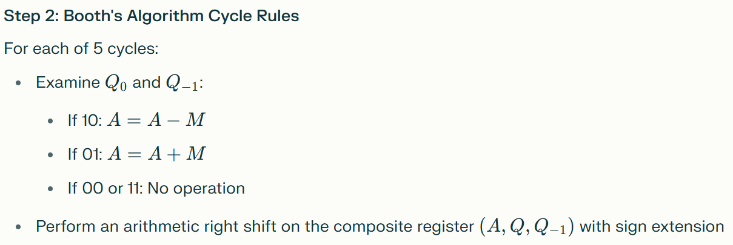

Slide 3
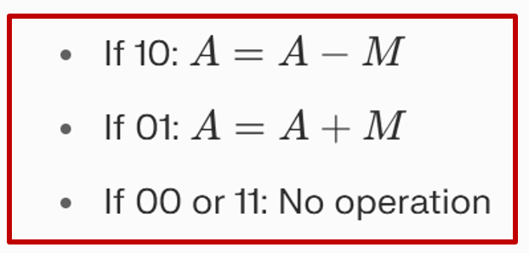
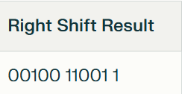
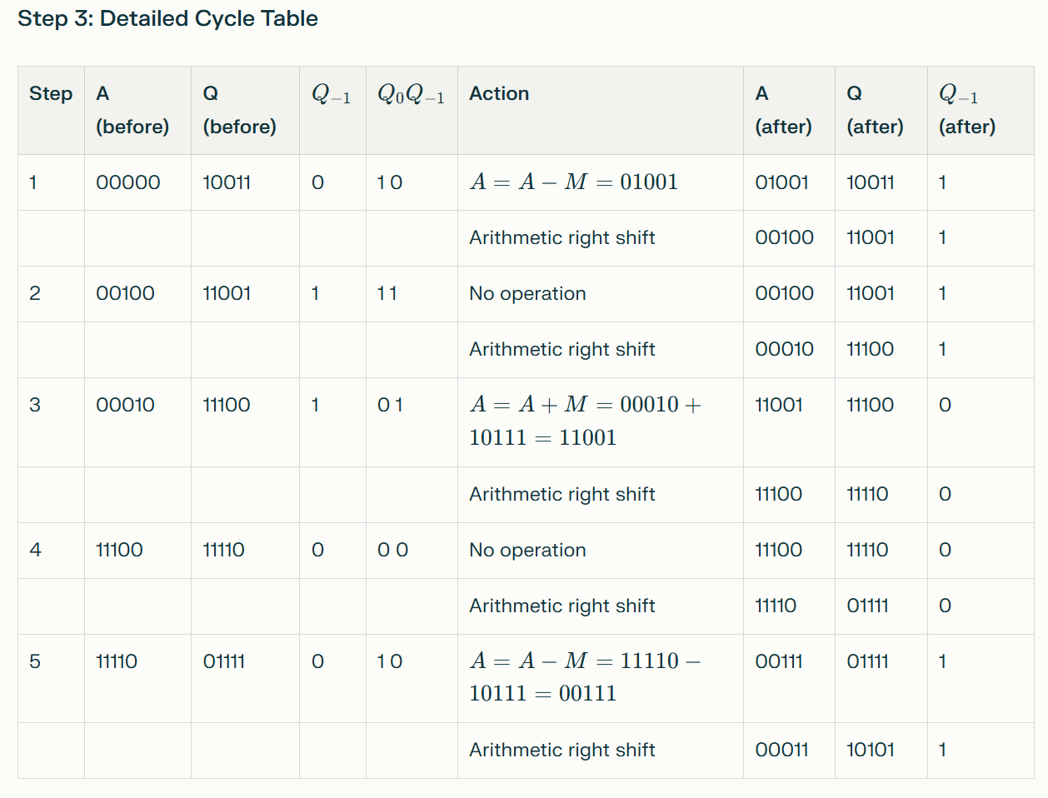


Slide 4
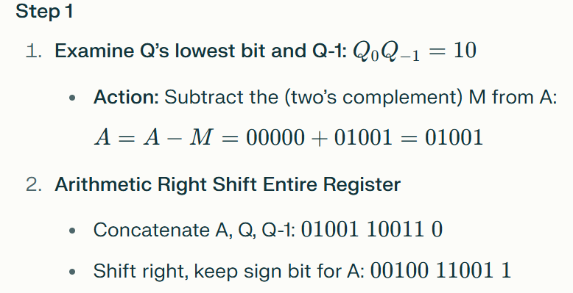
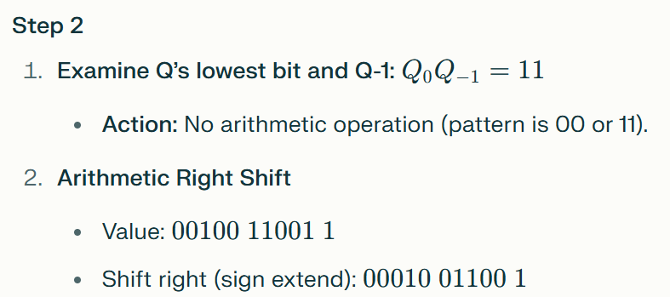
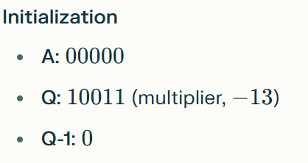
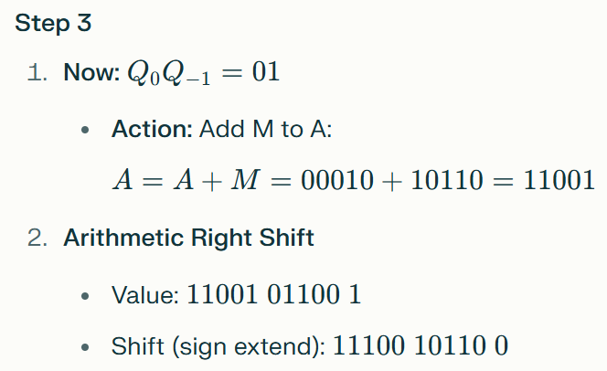
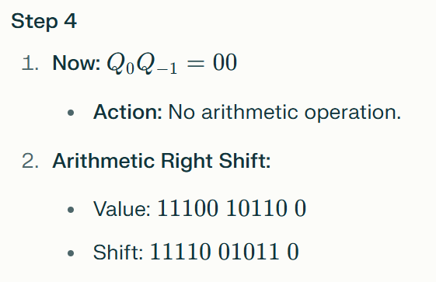
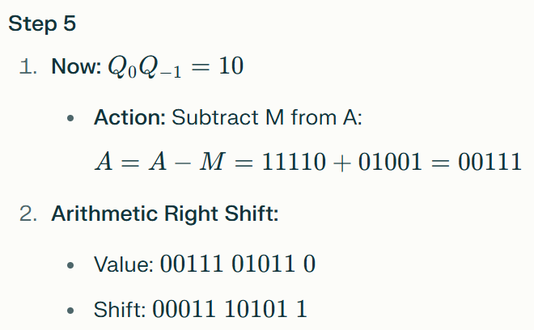

Slide 5
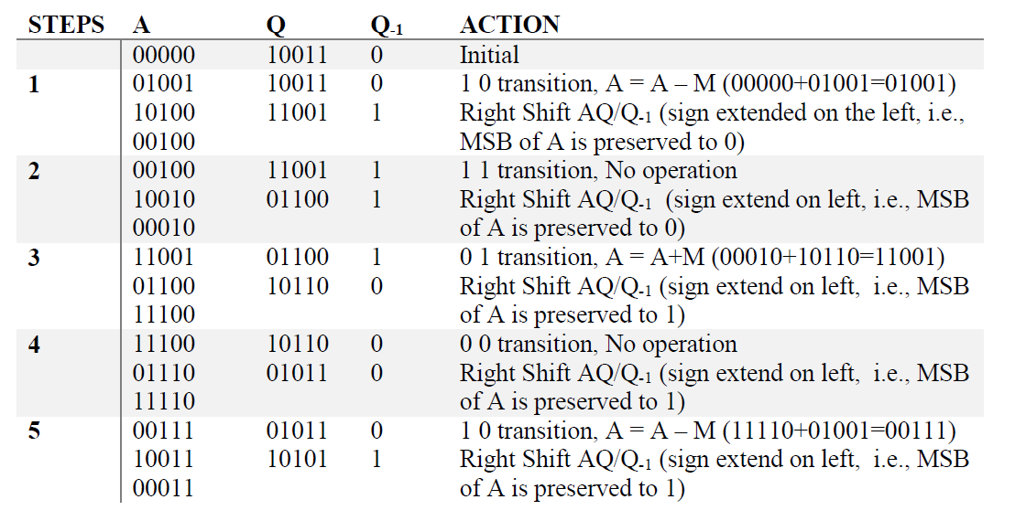

Slide 6

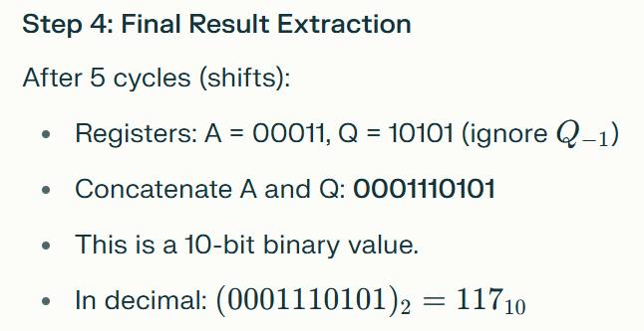


Slide 7


Slide 8
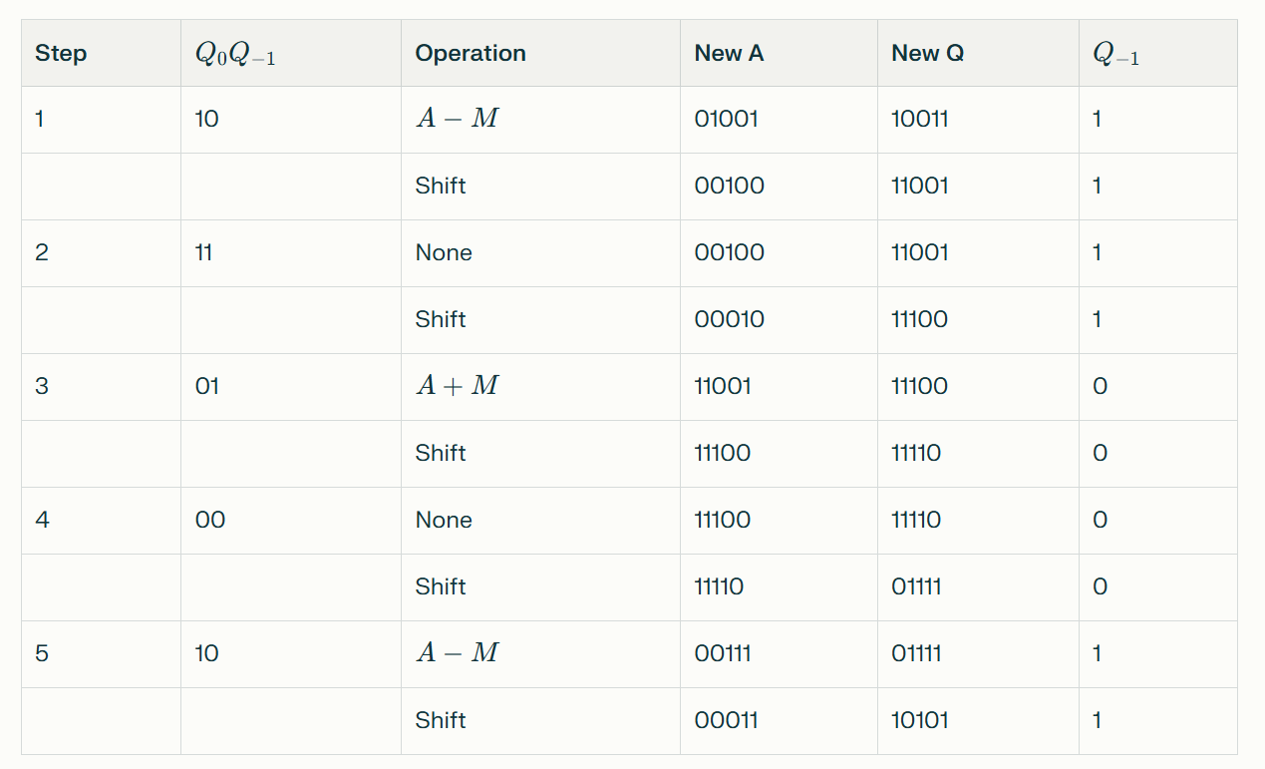

Slide 9
Question 2
Ques 2: Use the restoration method to find 8 divided by 3.

Slide 10
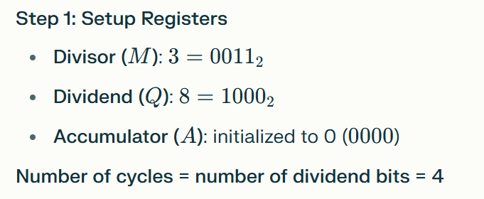
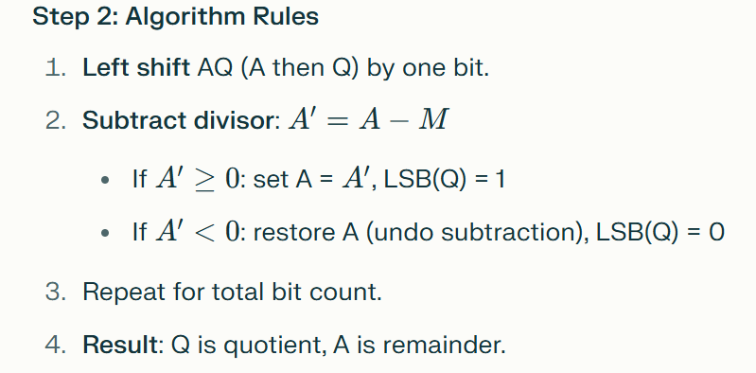

Slide 11
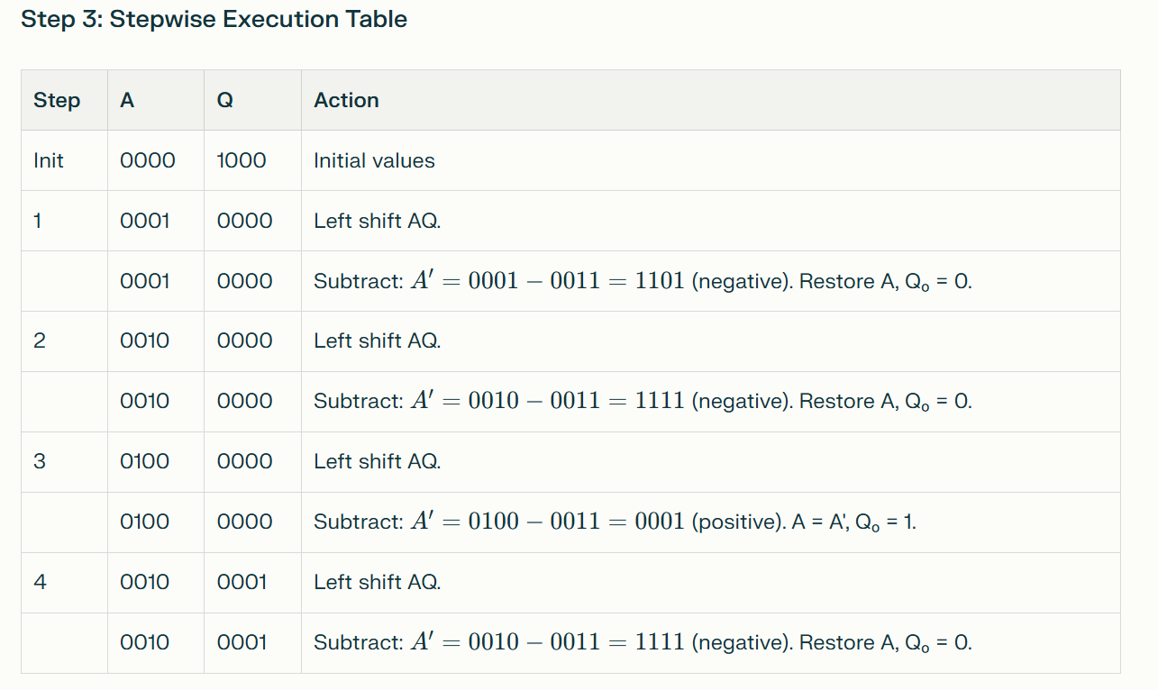

Slide 12

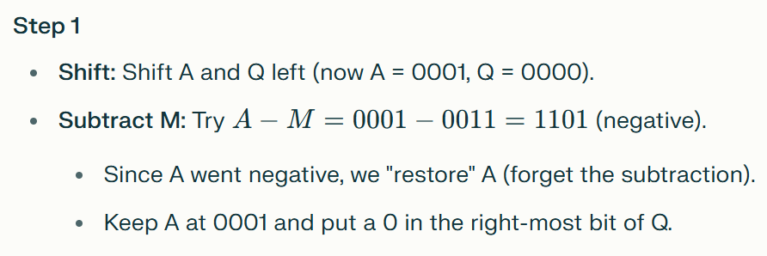
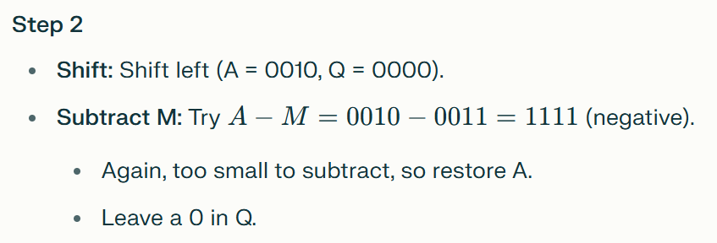

Slide 13
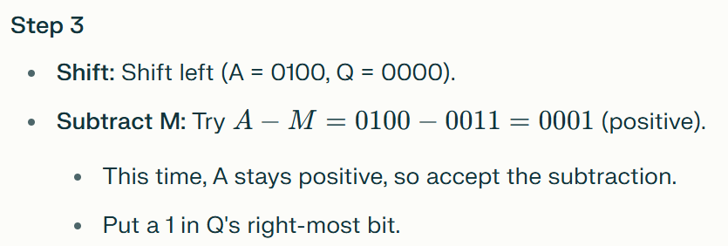
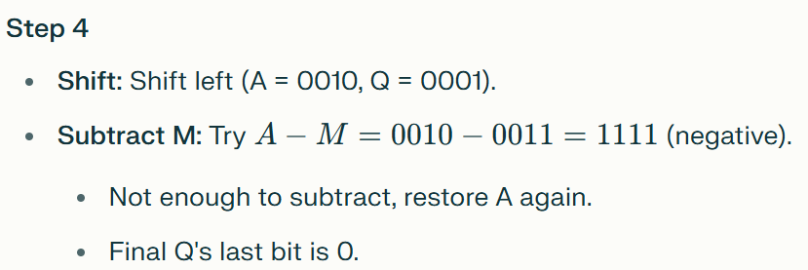


Slide 14
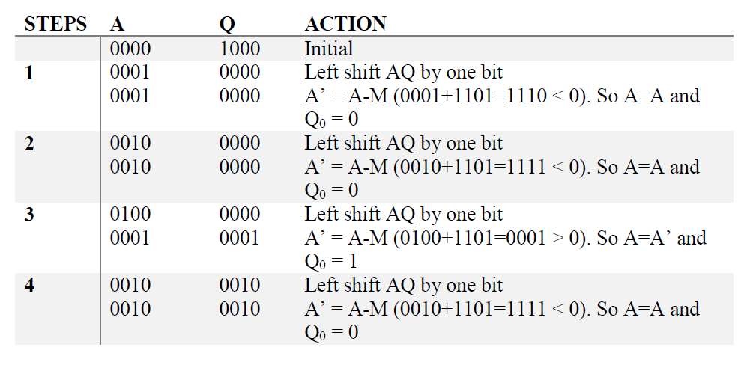

Slide 15
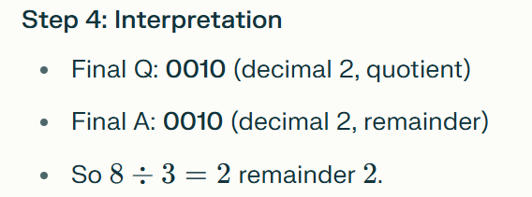

Shift AQ left, subtract divisor from accumulator.
If result is negative, undo and set quotient bit 0.
If result is positive, keep result and set quotient bit 1.
Repeat for all bits.
Read registers: Q = quotient, A = remainder

Slide 16
Question 3
Ques 3: Use the non-restoration method to find 8 divided by 3.

Slide 17
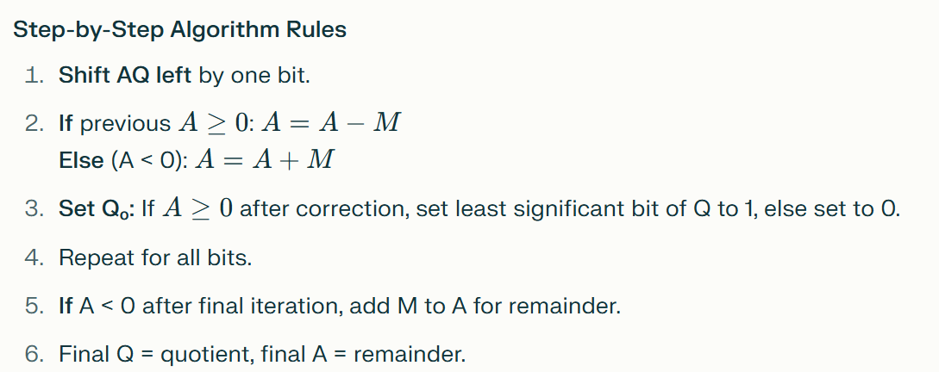
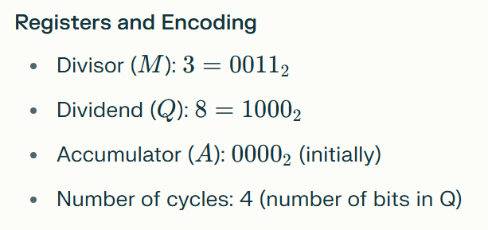

Slide 18
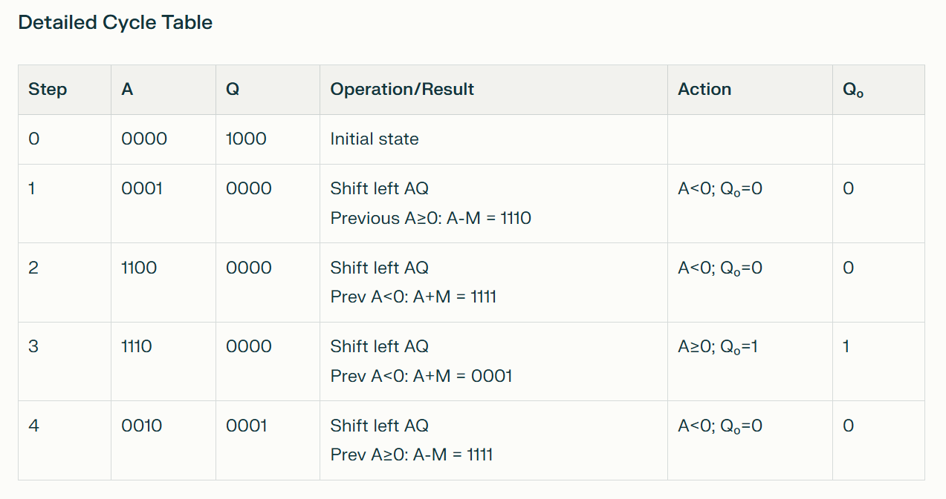

Slide 19




Slide 20
Key Points for Slides:
The non-restoration method alternates between subtraction and addition based on the sign of accumulator A at each cycle.
If A is negative at the end, correct once by adding M.
Quotient is in Q, remainder is in A.
Final Answer:
Quotient = 2; Remainder = 2; 8÷3=8÷3=2 remainder 2

